Slide 1

Andes
(Andromeda Delivery System)

Slide 2


DFD
Konsumen
Bag.
Administratif

Slide 3
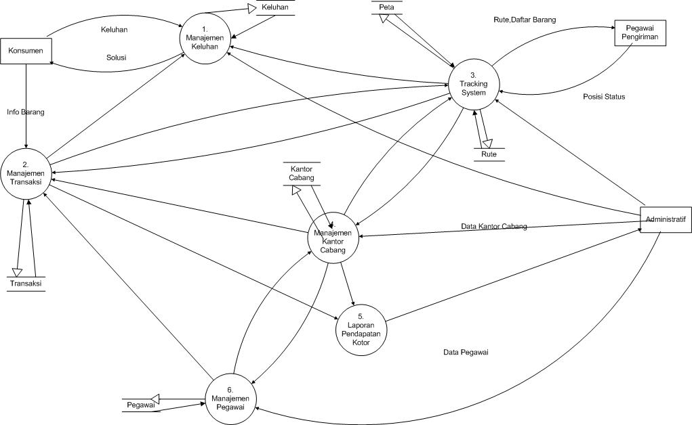
DFD Level 1

Slide 4
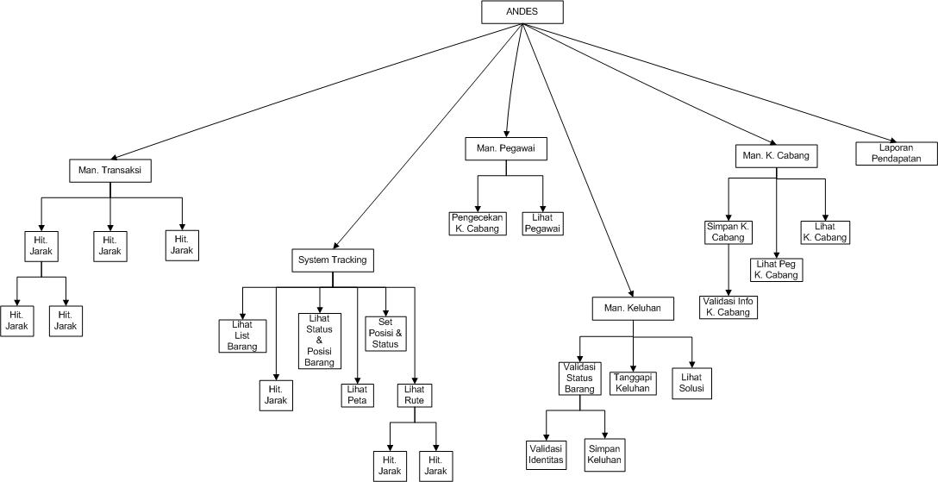
Structure Chart

Slide 5
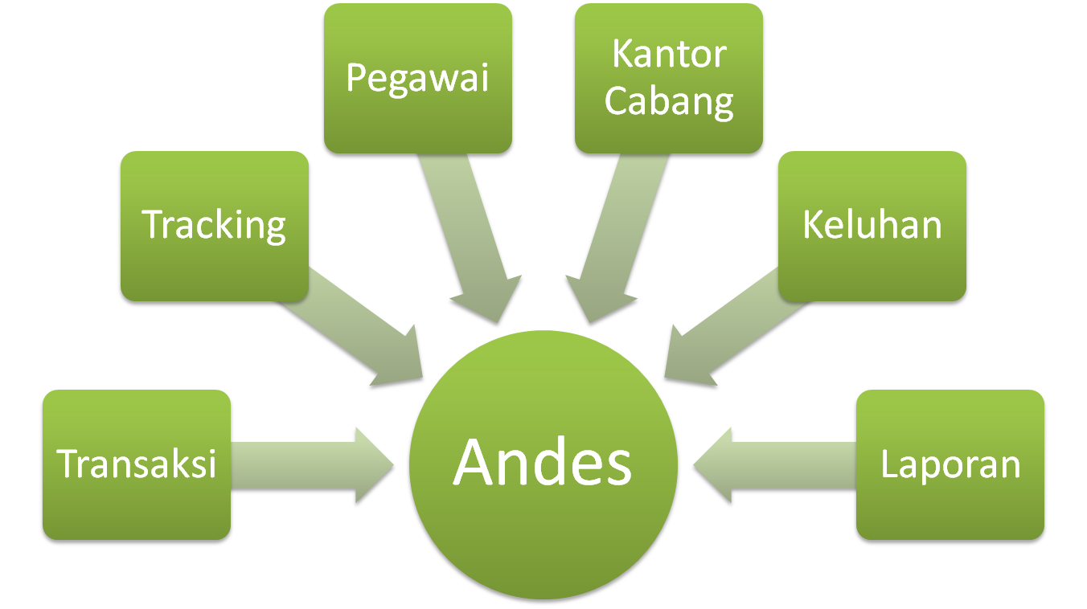
Modules

Slide 6
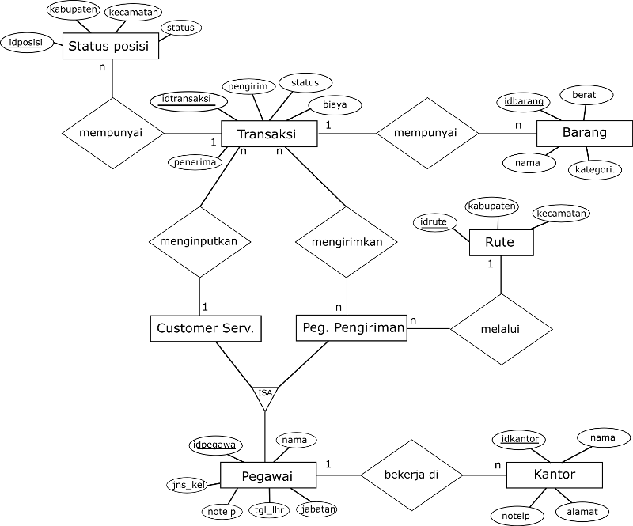
ER Diagram

Slide 7
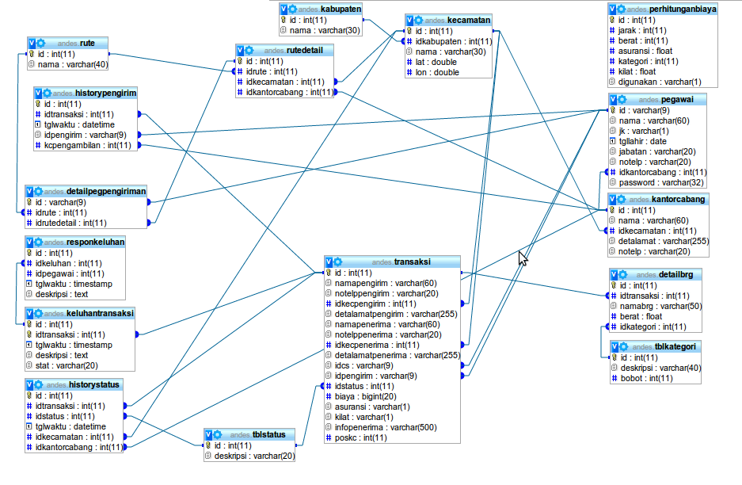
Implementation of ER

